Slide 1
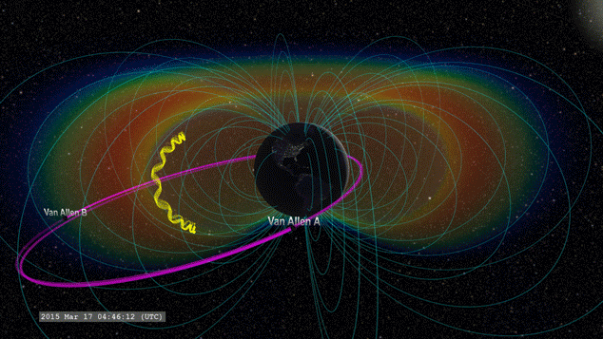
Charged particle motion and precipitation
Notes:
NOAA POES – 30 deg field of view
references

Slide 2
Charged particle motion and precipitation
Pitch Angle:
J. Sample, PhD Thesis (2013)
Notes:
NOAA POES – 30 deg field of view
references

Slide 3
Earth

